Slide 1
League of Legends Win Analysis
Eric Mei
12.12.23

Slide 2
Contents
Background & Key Objective
Data Understanding
Data Preparation
Modeling
Model Interpretation
Deployment

Slide 3
Background & Key Objective

Slide 4
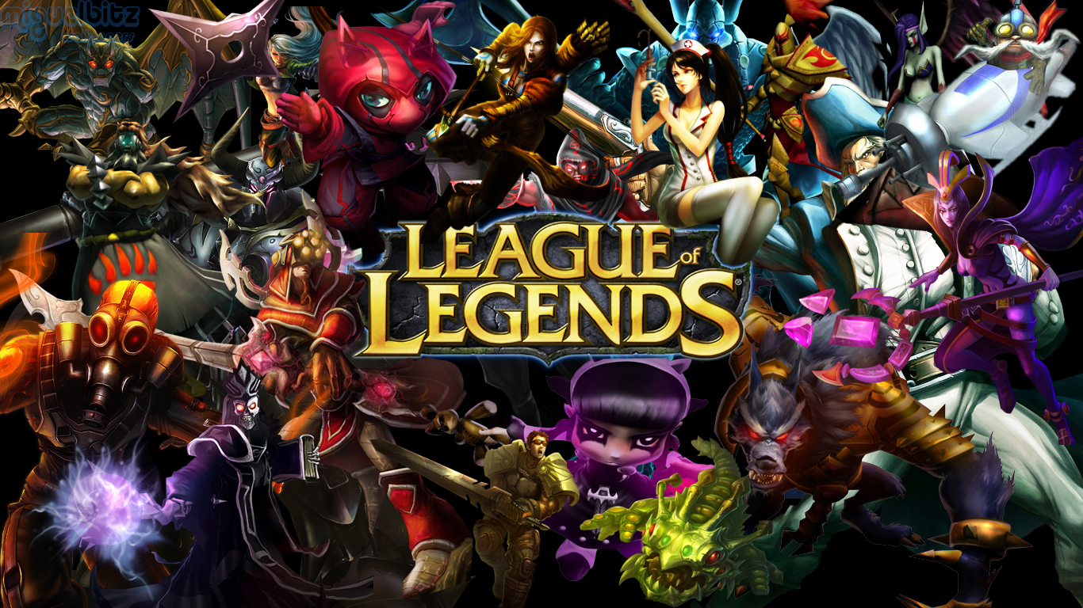
Background
League of Legends" (LoL) is a popular multiplayer online battle arena (MOBA) game developed and published by Riot Games. First released in 2009, it has since become one of the most played and widely recognized games in the world, particularly known for its competitive E-Sports scene.

Slide 5
Key Objective
Use deep learning methods to build models that can predict winning chances for ranked players using in game stats as the game goes on. Furthermore, we can use results of the model to generate insights for players to improve their winning chances.

Slide 6
Data Understanding

Slide 7
Data Understanding
Kaggle data
9879 ranked games (Diamond 1 - Master)
40 columns
At 10 minute mark
No missing values
Target (y): blueWins

Slide 8
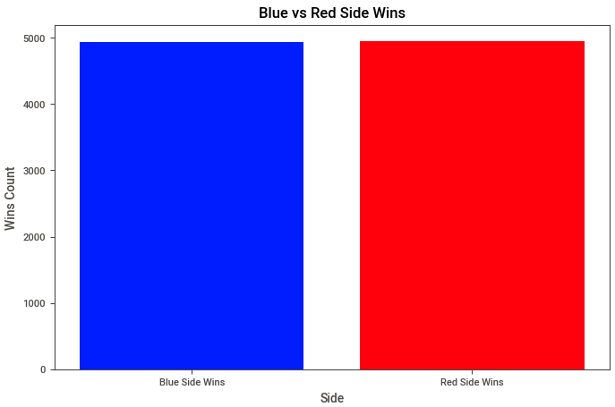
Data Understanding - EDA
Win/Lose

Slide 9
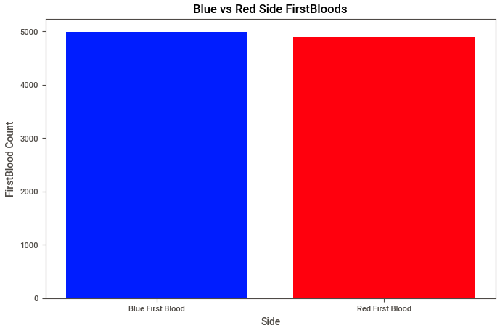
Data Understanding - EDA
First Blood

Slide 10
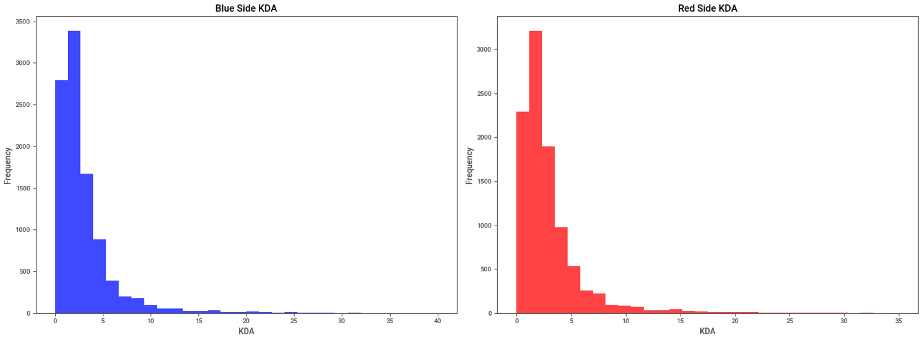
Data Understanding - EDA
Kills Deaths Assists

Slide 11
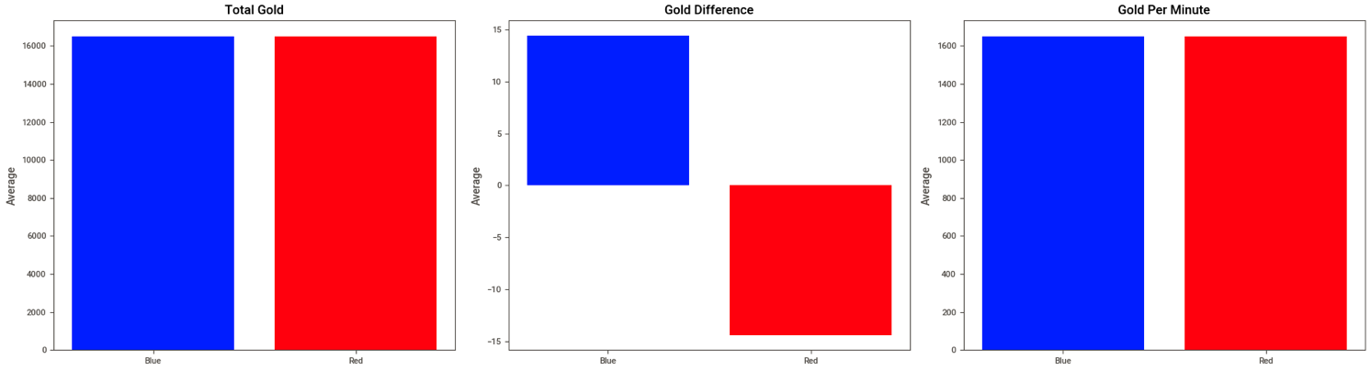
Data Understanding - EDA
Gold

Slide 12
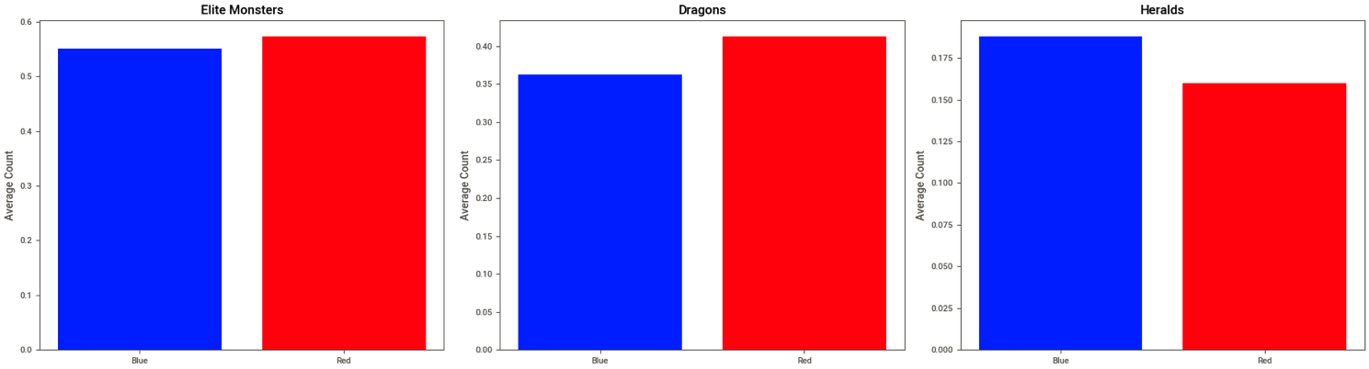
Data Understanding - EDA
Neutral Objectives

Slide 13
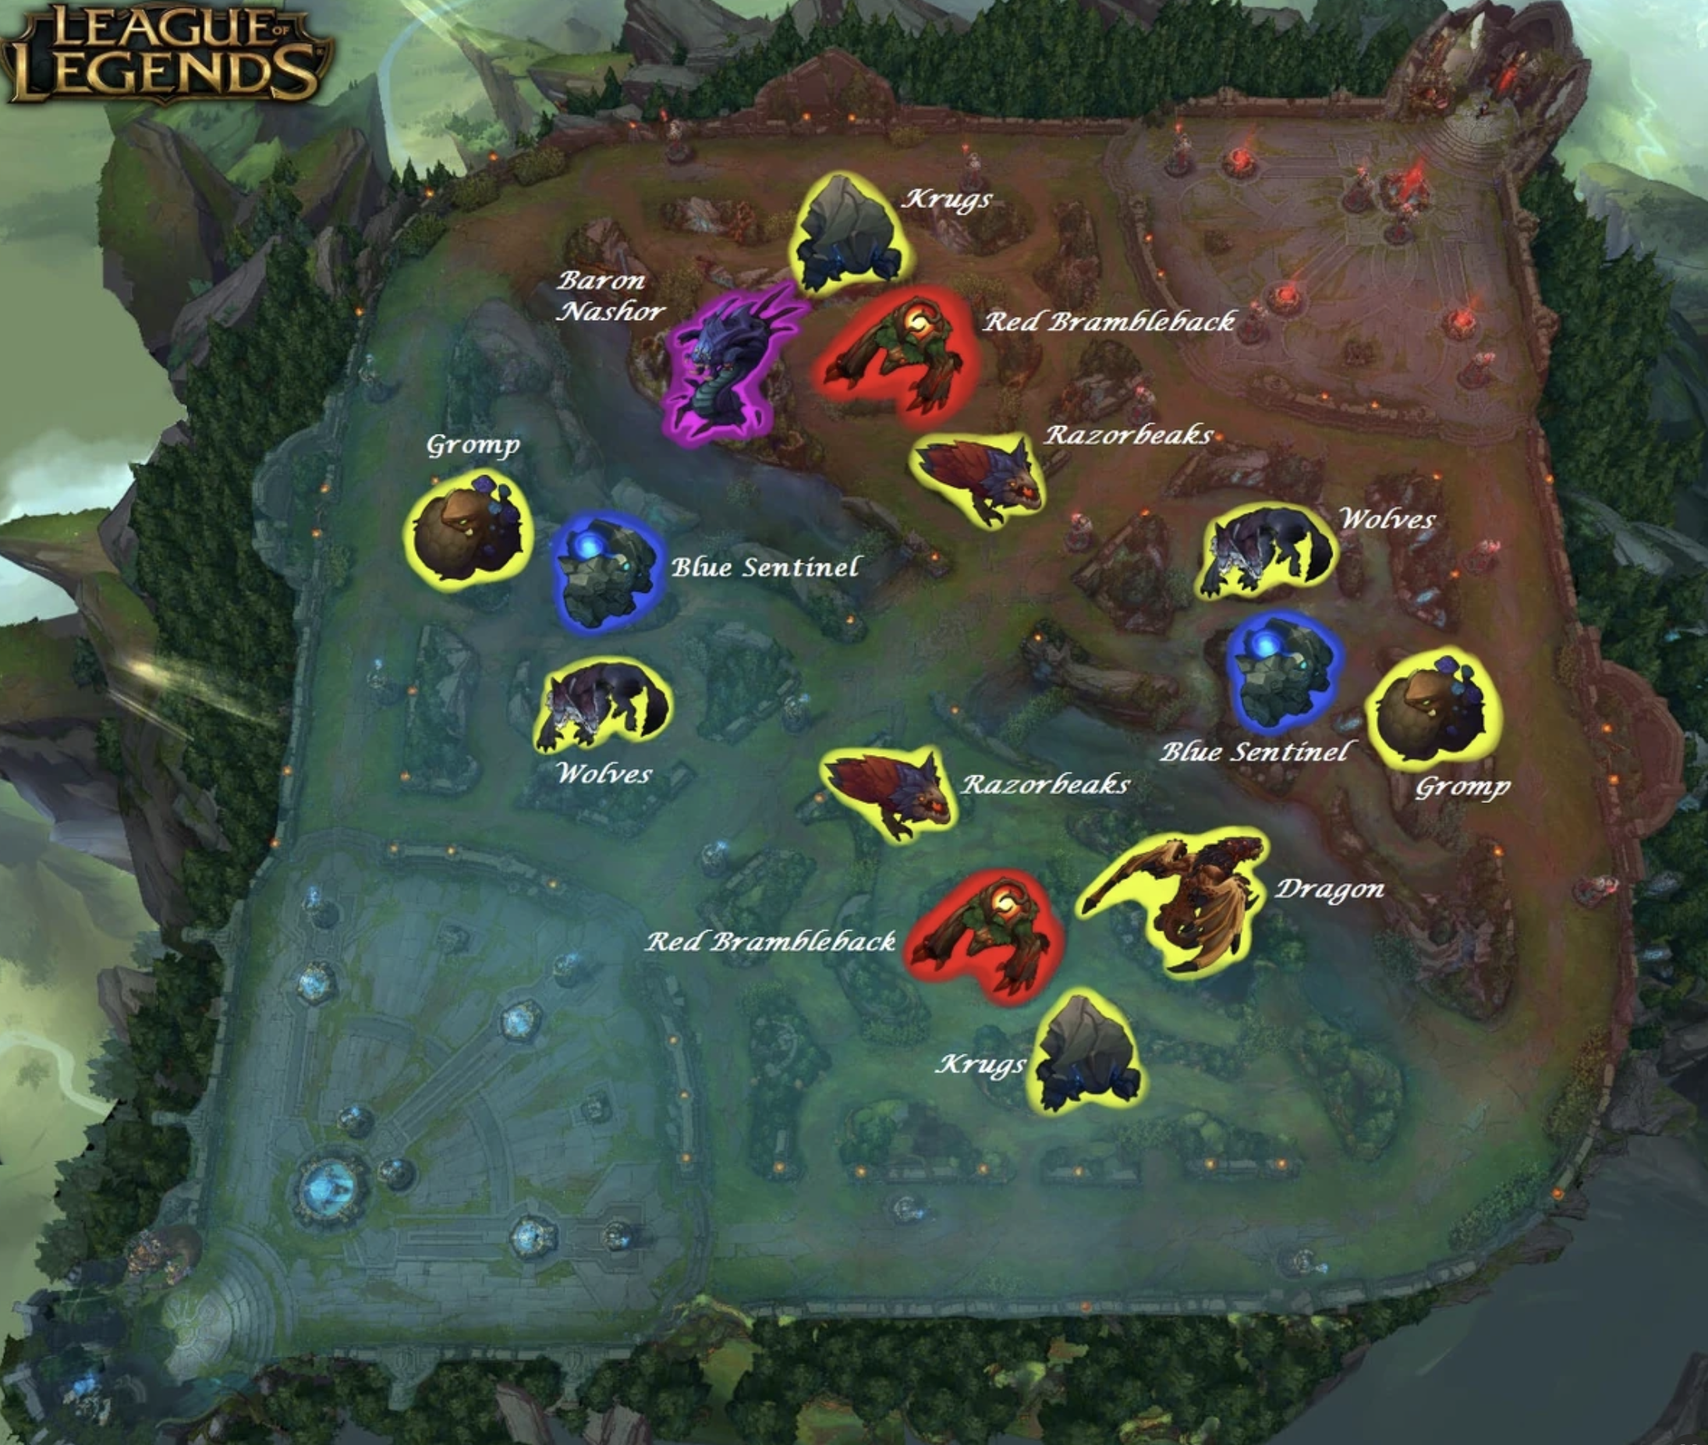
Data Understanding - EDA
Neutral Objectives

Slide 14
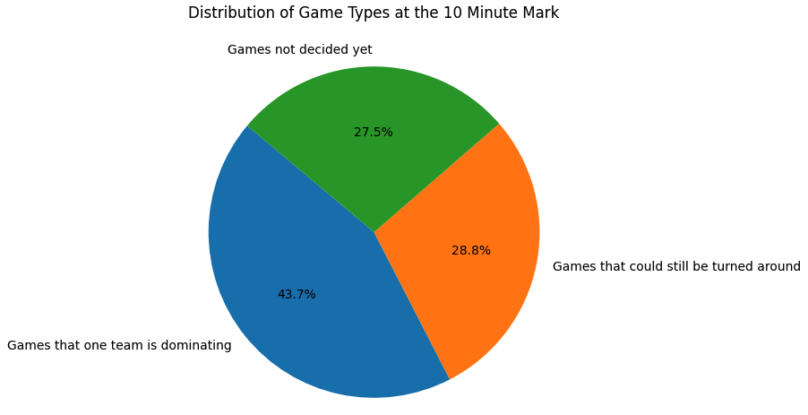
Data Understanding - EDA
Factor Analysis + Cluster Analysis
6 factors + 8 segments

Slide 15
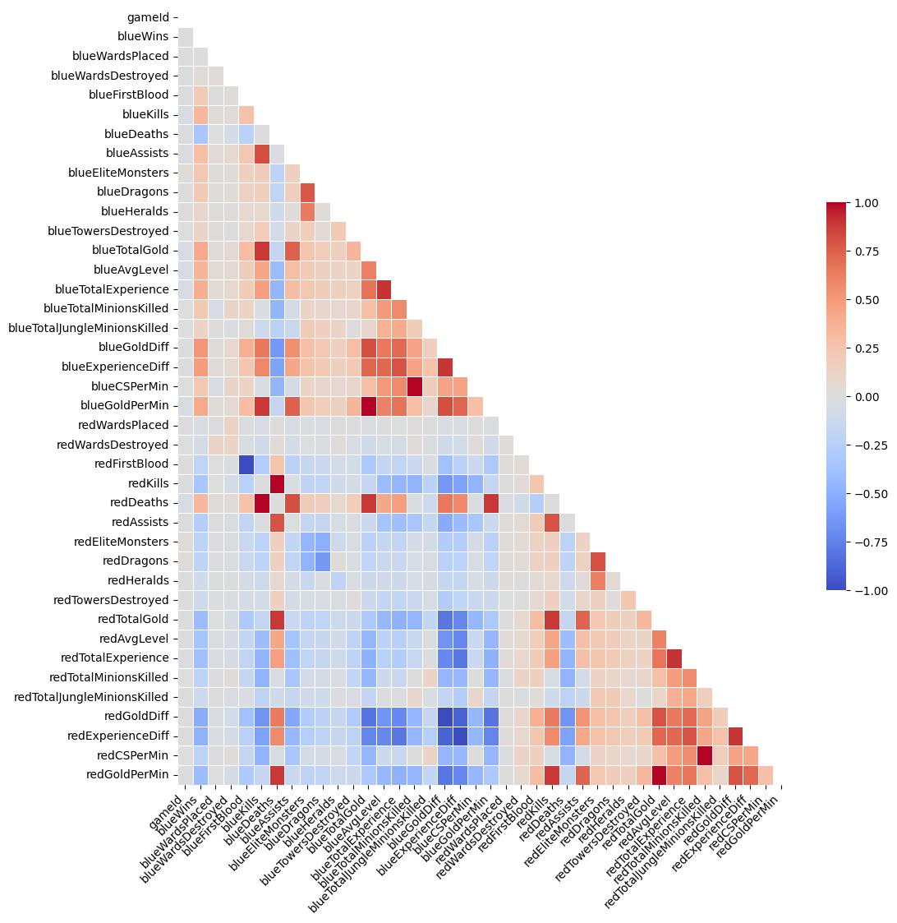
Data Understanding
Correlation Matrix

Slide 16
Data Preparation

Slide 17
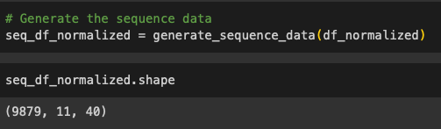
Data Preparation
I generated sequence data for LSTM model.

Slide 18
Data Preparation
Generate sequence data
Numeric columns normalization
Data splitting (80%/10%/10%)
Data loading
Data Batching

Slide 19
Modeling

Slide 20
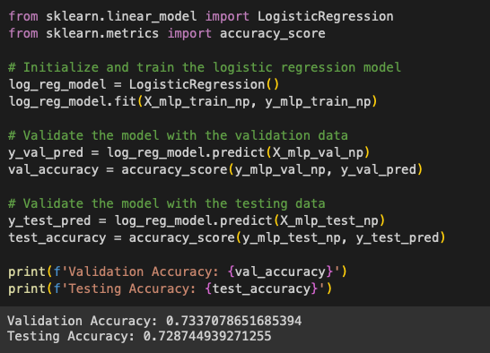
Modeling - Benchmark
Logistic Regression as benchmark

Slide 21
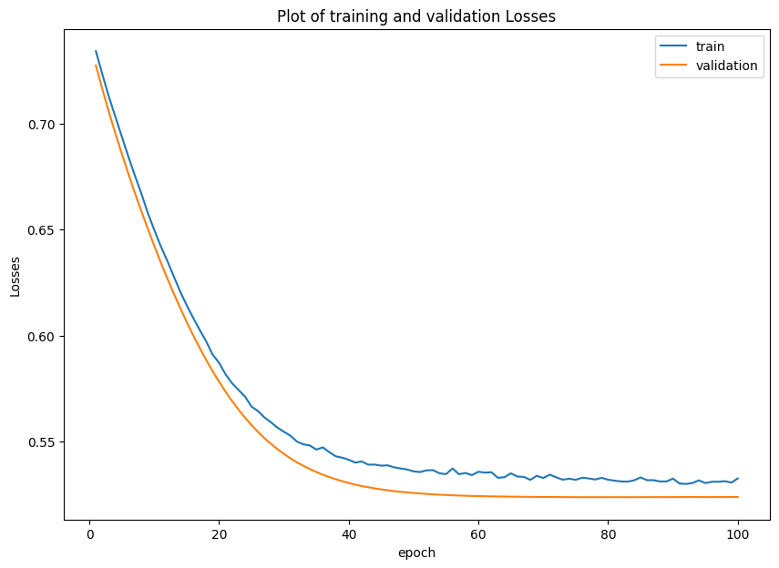
Modeling - MLP Model
Loss Function: BCE Loss
Regularization: Dropout + L2
Optimization:
Manually first (find range)
Bayesian Optimization (50 trials)
Manually last (to find best)
Save model (val loss decrease)

Slide 22
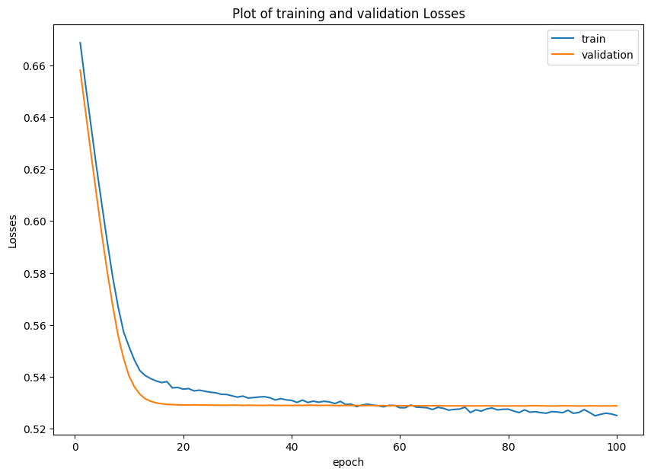
Modeling - LSTM Model
Loss Function: BCE Loss
Regularization: Dropout + L2
Optimization:
Only manually
Save model (val loss decrease)

Slide 23
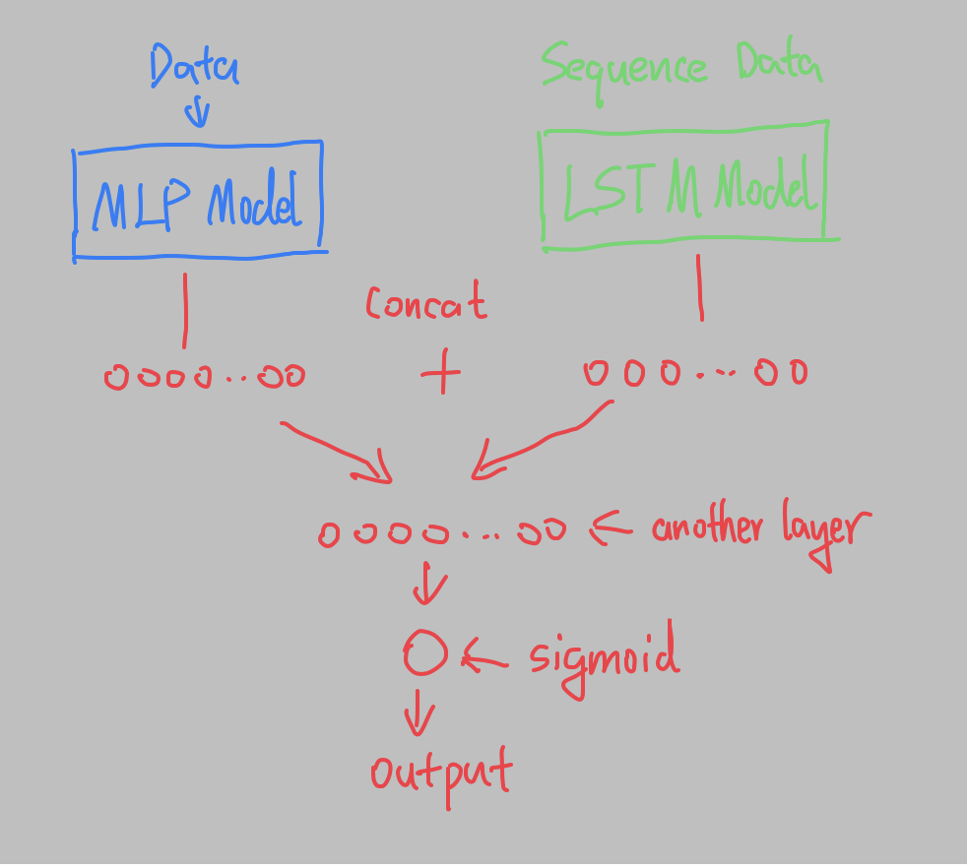
Modeling - Combining Models
Averaging
Simply take the average
Weighted Average
Function
Stacking
Logistic Regression on results
Model Blending

Slide 24
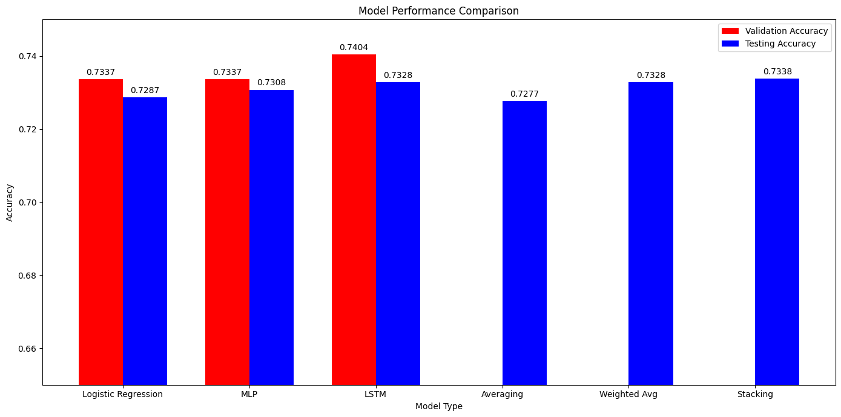
Modeling - Compare

Slide 25
Modeling - Conclusion
Logistic Regression - best suited for the task
MLP did not perform as well because of data limitation
LSTM performed better than expected because of domain knowledge
Combining models did help
Stacking performed the best
Couldnt get model blending to work

Slide 26
Model Interpretation

Slide 27
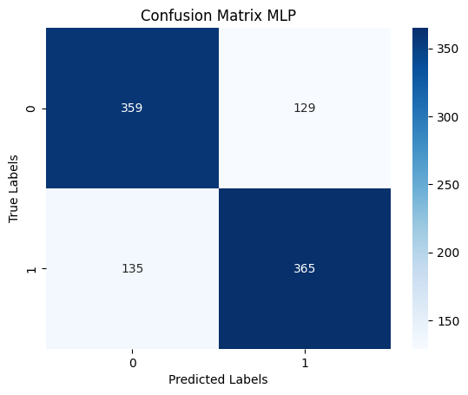
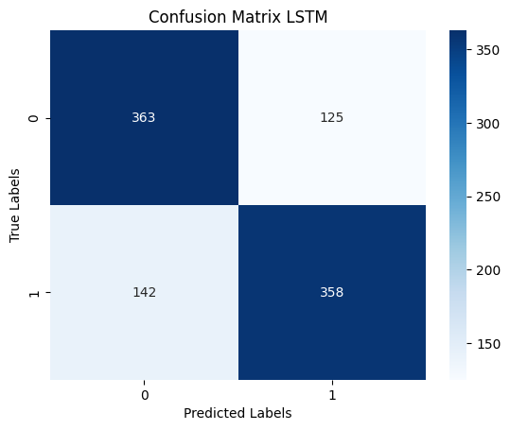
Model Interpretation - Confusion Matrix

Slide 28
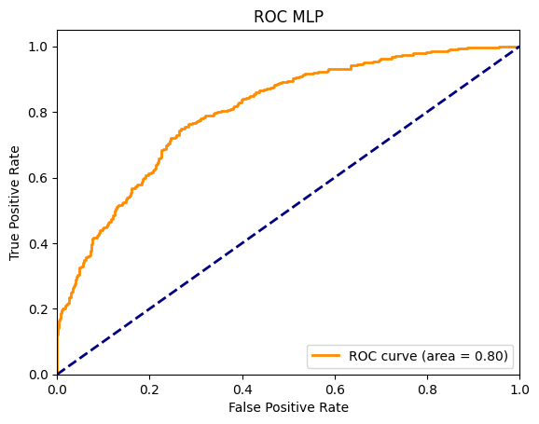

Model Interpretation - ROC Curve

Slide 29
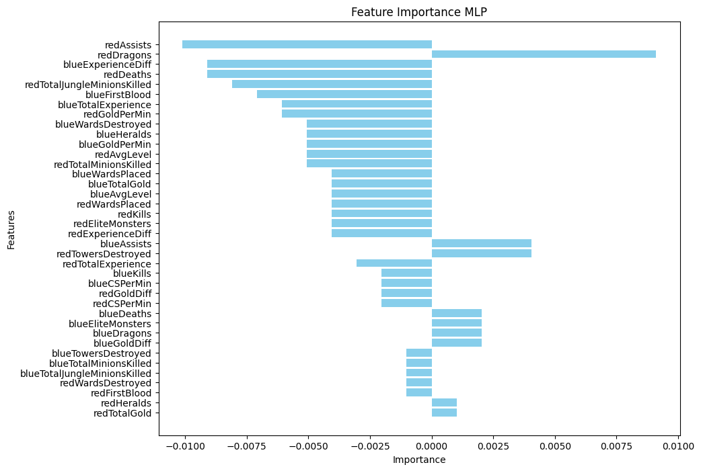
Model Interpretation - Feature Importance
Permutation
Importance

Slide 30
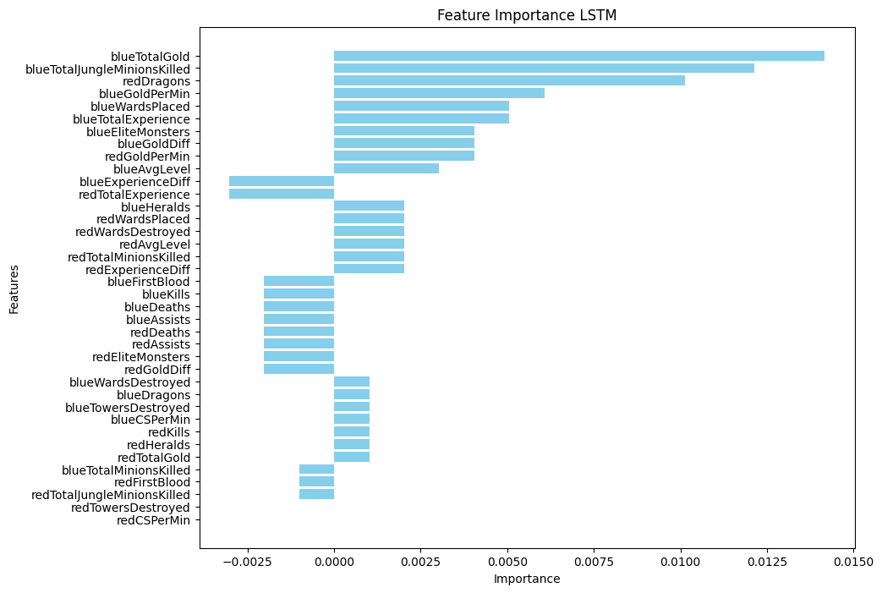
Model Interpretation - Feature Importance
Permutation
Importance

Slide 31
Model Interpretation - Feature Importance
Elite Monsters are important even early game!!!
Most importantly dragons!!!

Slide 32
Deployment

Slide 33
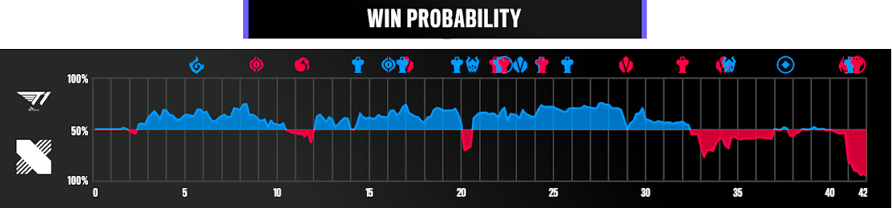
Deployment
I can:
Using the LSTM model, predict winning chances of a team when the game is going.

Slide 34
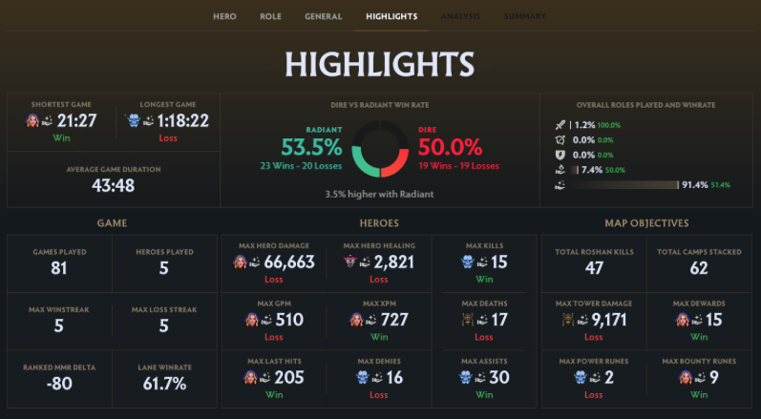
Deployment
With more data,
Potentially:
With the help of generative AI, and more data, generate in game real time feedback for players.

Slide 35
Deployment
I could even:
Build live commentary assistance tool for E-Sports live commentary as the game goes.

Slide 36
Thank You!

